Slide 1
Real-Time Payment Analytics Dashboard
Real-Time Analytics Dashboard using Apache Cassandra

Slide 2

The Problem Statement

Slide 3

The Solution - NoSQL & Apache Cassandra
Database Choice: Apache Cassandra
Masterless Architecture: No single point of failure; all nodes are equal.
Linear Scalability: Add more nodes to increase throughput and storage.
Write Optimization: Append-only log structure enables incredibly fast, durable writes.
Built-in Aggregations: Specialized data types like Counters for real-time metrics.
It is specifically designed for:
High Availability: Its masterless, peer-to-peer architecture means the system stays up even if nodes fail.
Massive Write Speed: It uses a commit log and memtable structure, making writing data incredibly fast and sequential, avoiding random disk I/O.
Real-Time Counters: It allows us to track metrics like 'Total Spending' with atomic increments, so we don't need to read and sum millions of rows on every dashboard load.

Slide 4
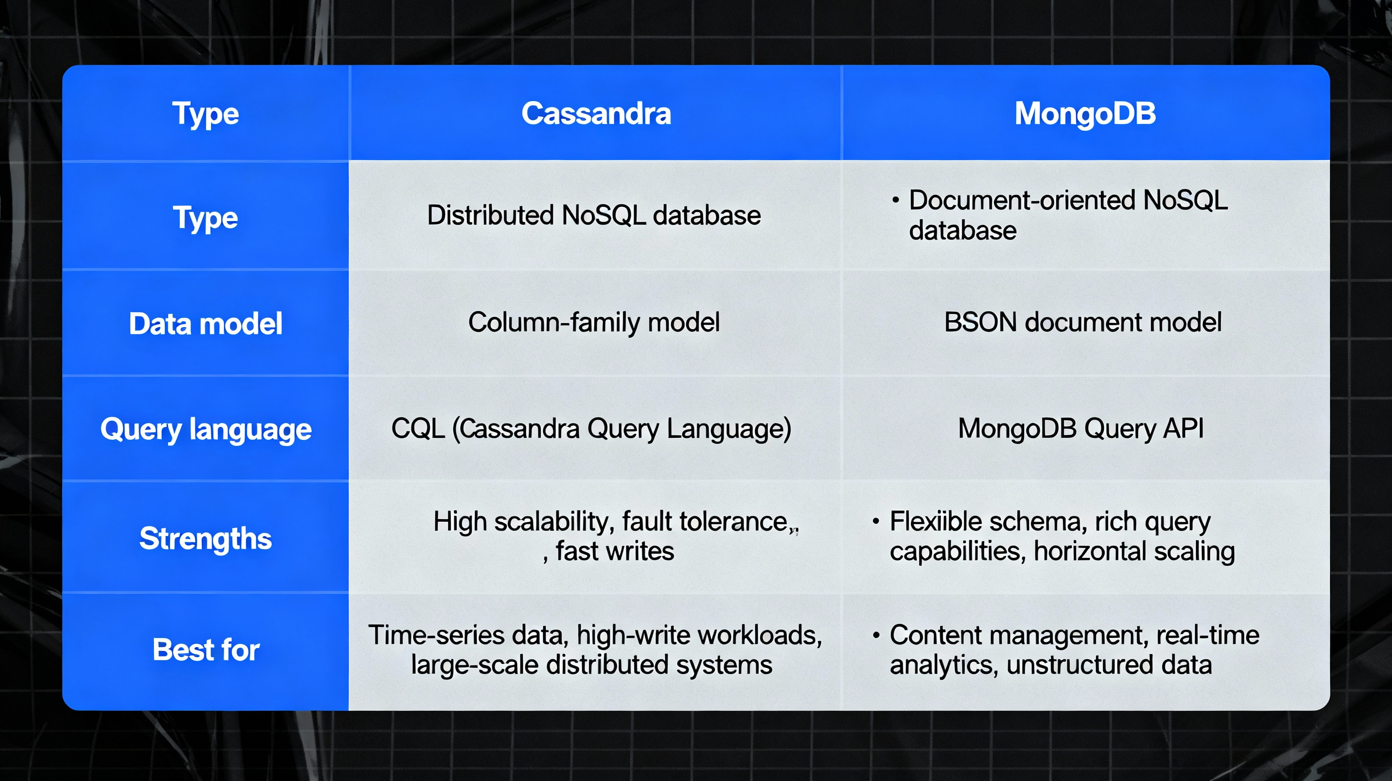
Data Model - Cassandra vs. MongoDB
.
Cassandra: Columnar Store (Wide-Column), Schema-based, Optimized for Writes (Log-structured), CQL (SQL-like).
MongoDB: Document Store (BSON/JSON), Schemaless, Flexible Nested Data.

Slide 5
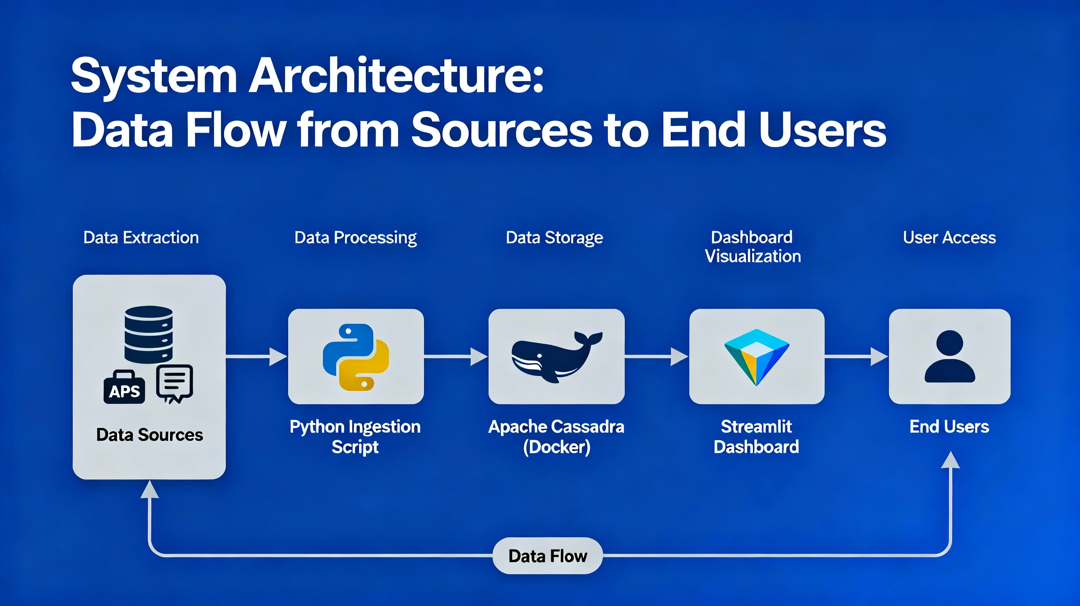
System Architecture
Ingestion Layer: Python script simulating a payment gateway.
Storage Layer: Apache Cassandra 4.0 running in a Docker container.
Presentation Layer: Streamlit dashboard for live data visualization.

Slide 6
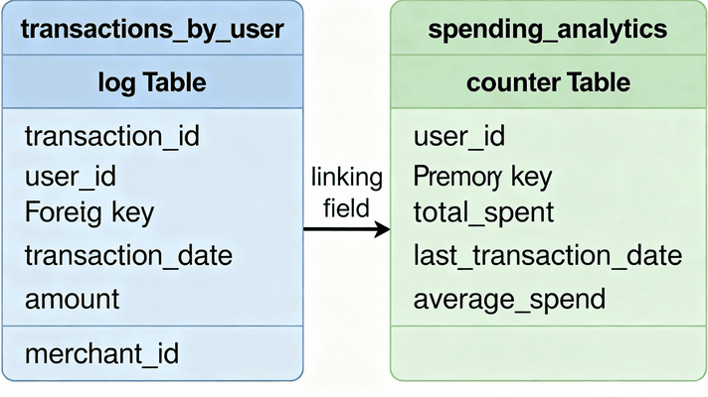
Database Schema (Query-First Design)
NoSQL Principle: Design tables based on queries, not on normalizing data.
Table 1: transactions_by_user (Log)
Purpose: Retrieve a user's full transaction history.
Partition Key: user_id (groups a user's data together).
Clustering Key: transaction_time DESC (shows latest transactions first).
Table 2: spending_by_user_category_month (Aggregates)
Purpose: Instantly get total spending per category.
Key Feature: Uses a counter data type for atomic, real-time increments.

Slide 7
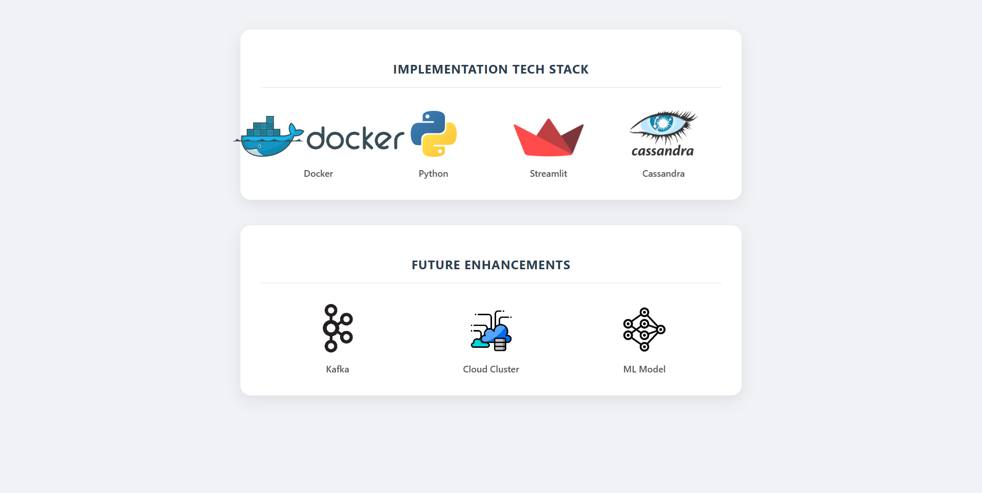
Implementation Tech Stack
Database: Apache Cassandra 4.0 (Docker)
Backend: Python 3.9 with DataStax cassandra-driver
Frontend: Streamlit for rapid dashboard development
Containerization: Docker for environment consistency
Data Source: Synthetic dataset reflecting real-world payment patterns.

Slide 8
Key Features
Asynchronous Pipeline: The producer doesn't wait for the database to say "OK" before sending the next transaction. This simulates high-throughput industrial systems.
Real-Time Fraud Rules: Simple logic to flag high-value transactions instantly.
Zero-Latency Aggregation: The "Spending by Category" chart loads instantly because the math is done during the write, not the read
Sub-Second Data Freshness: From transaction generation to dashboard visualization.

Slide 9
Demo
A key point
Another point
A third point
A final point
This matters too! Now you just need to convince your audience with facts (or GIFs).
Why is it important? More importantly, why does it matter?
You already know that it’s important. But what about your listeners?
Write as much or as little as you want. Remember to explain why it matters.

Slide 10

Challenges Faced
Understanding Consistency:
Paradigm Shift
Docker Networking
Learning Cassandra's eventual consistency model and tuning read/write consistency levels for our needs.
Moving from SQL joins and normalization to NoSQL's query-first denormalization.
Configuring the Python script to correctly communicate with the containerized database.

Slide 11
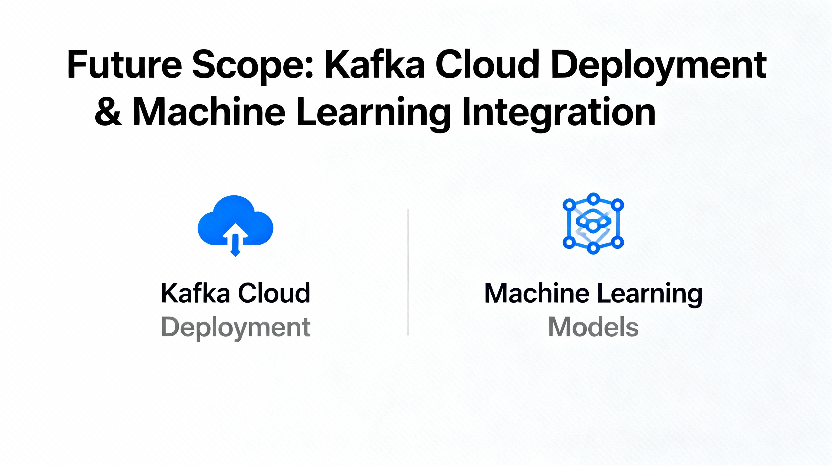
Conclusion & Future Scope
Conclusion: Successfully demonstrated a scalable, write-optimized NoSQL architecture for modern FinTech applications using Apache Cassandra.
Future Enhancements:
Integrate Apache Kafka: To create a more robust, decoupled streaming pipeline for handling massive traffic spikes.
Cloud Deployment: Deploy on a 3-node cloud cluster (AWS/GCP) for true fault tolerance and global distribution.
ML-Based Fraud Detection: Replace rule-based logic with a machine learning model for more sophisticated, adaptive fraud detection.

Slide 12

Thank You!!

Slide 13



